Slide 1

VSP Onboarding Kickoff
VA.gov | [new team]
Emily Waggoner, Lead UX Designer
emily@adhocteam.us
July 18, 2019

Slide 2
Welcome!

Slide 3
Agenda
VSP ONBOARDING
Introductions
How the Platform works
Working together
Communication norms and escalation paths
Embracing collaboration
Documentation overview
What’s next
Feedback
Questions and discussion

Slide 4
Introductions

Slide 5
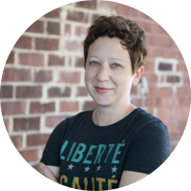
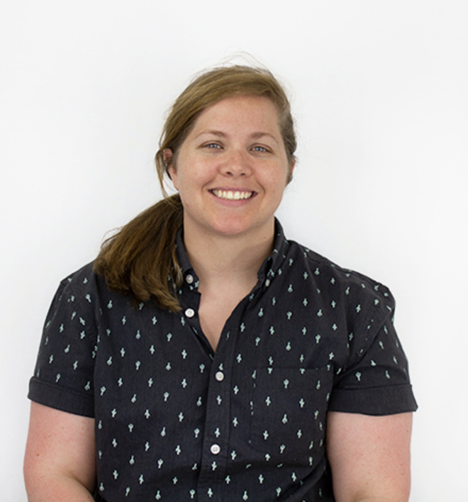
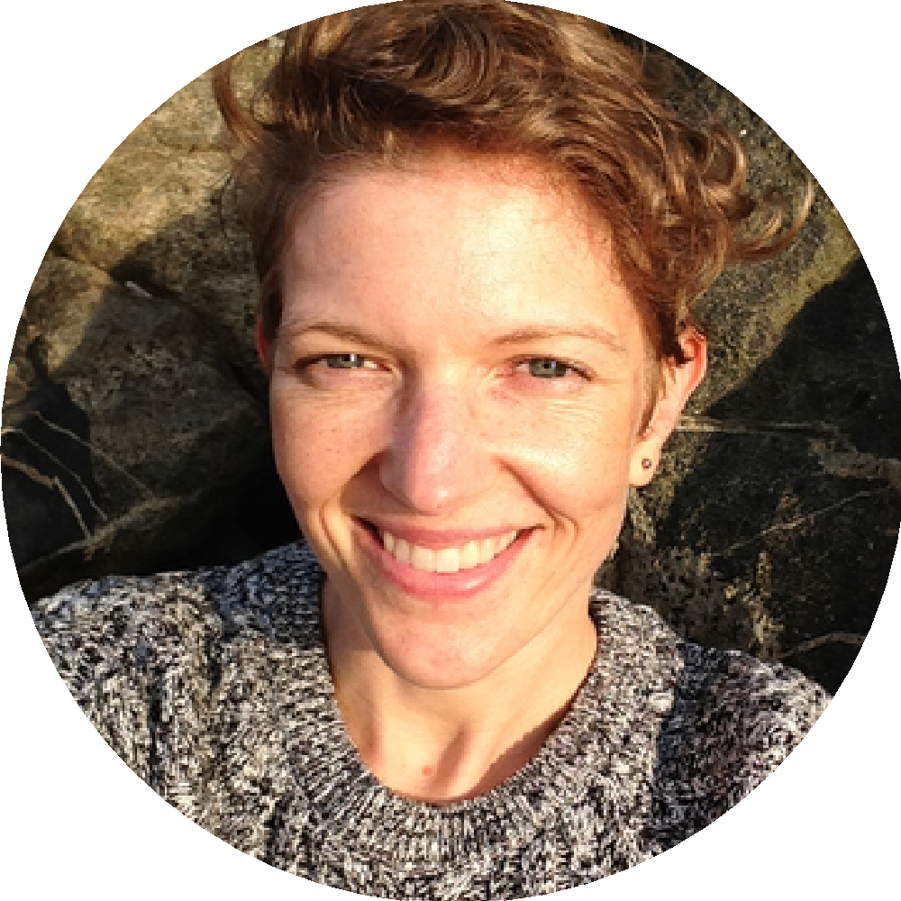




Who we are
VSP ONBOARDING
Emily Waggoner
UX Design Lead, VSP
Slack: @emily
Layla Soileau
Senior UX Designer
VSP Product Support
Slack: @layla
Andrea Hewitt
Product Manager
VSP Product Support
Slack: @AndreaHewitt
Bill Tran
Frontend Engineer
VSP Product Support
Slack: @Bill John Tran
Trevor Pierce
Accessibility Expert
VSP Product Support
Slack: @Trevor Pierce
Peter Hill
QA Specialist
VSP Product Support
Slack: @Peter Hill

Slide 6
Who are you?
VSP ONBOARDING
One minute each:
Name
Role
What are you excited about?
What are you nervous about?
Notes:
Emily facilitates
Layla takes notes

Slide 7
How the Platform works
Notes:
Emily

Slide 8

How VFS teams work
UX ONBOARDING
Agile, two-week sprints
Veteran-centered design
Discovery
Prototype
Test
Launch
Build
Notes:
Layla

Slide 9
How the Veteran Services Platform (VSP) works
VSP ONBOARDING
VSP is a constantly evolving product
MVP processes, iterating as we go
Feedback loops
Let us know what's working!
Feedback surveys

Slide 10
Working together

Slide 11
Communication norms and escalation paths

Slide 12
Slack
VSP ONBOARDING
Your team: #by-light-general
Join practice area-specific Slack channels
Default to generating discussion and asking questions in public channels
Use DMs when it truly needs to be private
Use wtf-bot to decode acronyms (/wtf ATO)
Everything in the DSVA Slack is subject to the Freedom of Information Act (FOIA)
Notes:
Emily

Slide 13
Logistics: Communication and escalation
VSP ONBOARDING
Slack channel for general support: #vfs-platform-support
Communication norms
Escalation path:
If you don't get a response within a few hours, @-mention someone you know in the channel to look at your question.
If you don't get a response within 1 business day, contact your DSVA Product Manager, who will make sure the right people address your question.

Slide 14
Tour of Slack
Notes:
Emily

Slide 15
GitHub
VSP ONBOARDING
Most of your work (or requests to others for work) should be connected to a ZenHub issue or product folder
Decisions made in Slack conversations and meetings should be documented in GitHub
Planning, notes, documentation should be in markdown (.md) files
Research documentation and design decisions should be stored in appropriate research folder within product folder
Cross-link any research to the research history
Notes:
Layla

Slide 16
Tour of GitHub & ZenHub
Notes:
Layla - Project structure GitHub, Project Zenhub, add a ticket with the template, add a bug

Slide 17
Email
UX ONBOARDING
Ideally only used when communicating with people outside the DSVA team, such as stakeholders
Notes:
Layla

Slide 18
Embracing collaboration

Slide 19
Working remotely or with remote teams
VSP ONBOARDING
Default to over-communicating
Take advantage of Zoom (in particular video)
Sit in on remote user research sessions
Find time to reach out and just chat with people
Notes:
Layla

Slide 20
Embracing collaboration
VSP ONBOARDING
Weekly cross-VA.gov Team of Teams meeting
Regular VSP reviews / check-ins
Practice-area specific Slack channels
Regular practice-area specific meetings
Other meetings and Slack collaboration as needed!

Slide 21
What to expect
VSP ONBOARDING
Product development checklist
Reviews to be conducted throughout the process
Accessibility, content, design, analytics, release plan, IA, security, privacy, production readiness/infrastructure
Other requirements
Call center scripts and documentation, points of contact, load testing, no major bugs
Learn and improve plan written
Using Zenhub for Workflow Management
Zenhub Onboarding PDF
Zenhub Product Management Guide
Product documentation best practices

Slide 22
Documentation overview
Notes:
Emily

Slide 23
Documentation overview
VSP ONBOARDING
Documentation Getting Started Guide
Va.gov Repo Map
va.gov-vfs-teams repository
vets-api repository
vets-website repository
va.gov-team repository
vets.gov-team repository
VA.gov Design System
VA.gov Content Style Guide
Front-end documentation

Slide 24
What’s next?
Notes:
Emily

Slide 25

What’s next?
VSP ONBOARDING
The rest of Day 1:
Design and Engineering breakout sessions
Join all the Slack channels
Accept all the calendar invites
Review product development criteria so you can make sure you're able to start working those concepts in from the beginning
Day 2 AM: Get machines set up for development
Day 2 PM: Discovery and Logistics workshop
If you haven’t yet, send us team names + emails so we can grant access to things
Keep us posted in Slack when you'd like help, guidance, or reviews!

Slide 26
5-minute survey
Link to survey
Notes:
Emily

Slide 27
Questions

Slide 28
How are you feeling?
VSP ONBOARDING
Has anything changed?
What are you excited about?
What are you nervous about?
What questions do you have?
Notes:
Layla facilitates
Emily takes notes

Slide 29


Slide 30
Thank you!

